Slide 1
Introduction to MATLAB
Tutor: Dr Amin Azimi

Slide 2
Aim
To understand and manipulate introductory features and functions to program in MATLAB.
Simulating a Simple Neuron Model Using the Leaky Integrate-and-Fire Model (LIF)

Slide 3
What is MATLAB?
MATrix LABoratory program (MATLAB), a high-level programming language and environment, initially written for scientists and engineers (in industry and academia) with interactive access to numerical computation libraries, and use matrix based techniques to solve problems without having to write programs in traditional languages e.g. C and Fortran.

Slide 4
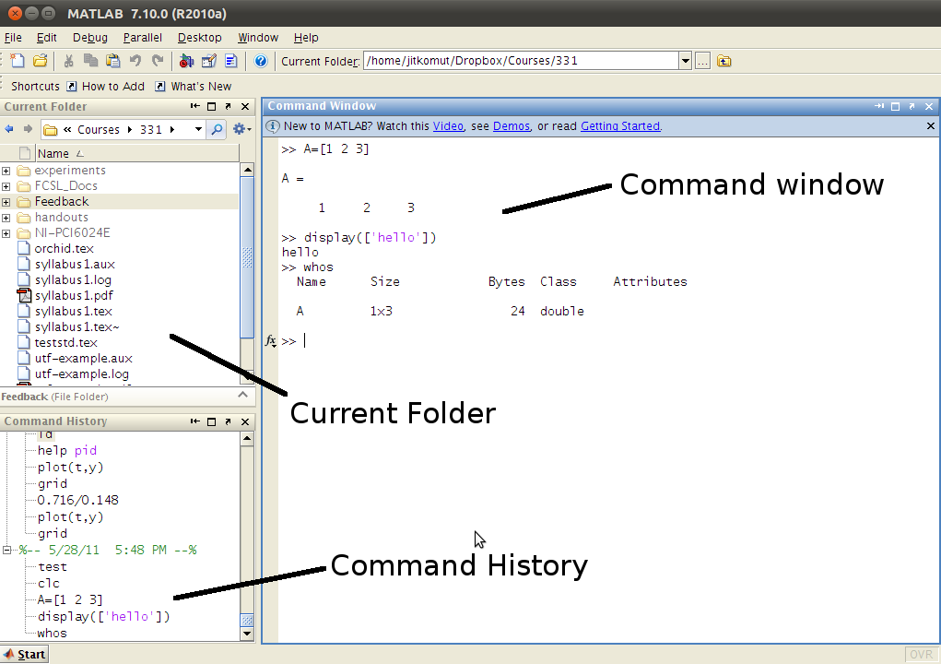
MATLAB environment

Slide 5
Advantages
User-Friendly Interface: Simplifies complex computations and tasks.
Extensive Mathematical Functions: Supports a wide range of engineering and scientific applications.
Robust Visualization Capabilities: Ideal for data analysis and presentation.
Versatile Usage: Perfect for developing algorithms, analyzing data, and simulating complex systems.
Preferred by Engineers, Scientists, Researchers, and Educators: A reliable tool for academic and professional use.

Slide 6
Disadvantages
Uses lots of memory and hard to use with slow computers
Expensive license

Slide 7
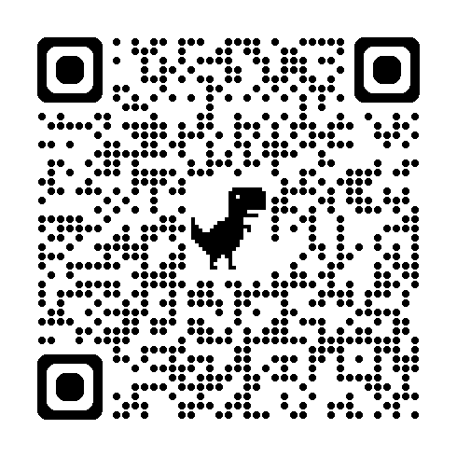
Download the lab tutorial file
https://tinyurl.com/2yuuyxs2

Slide 8
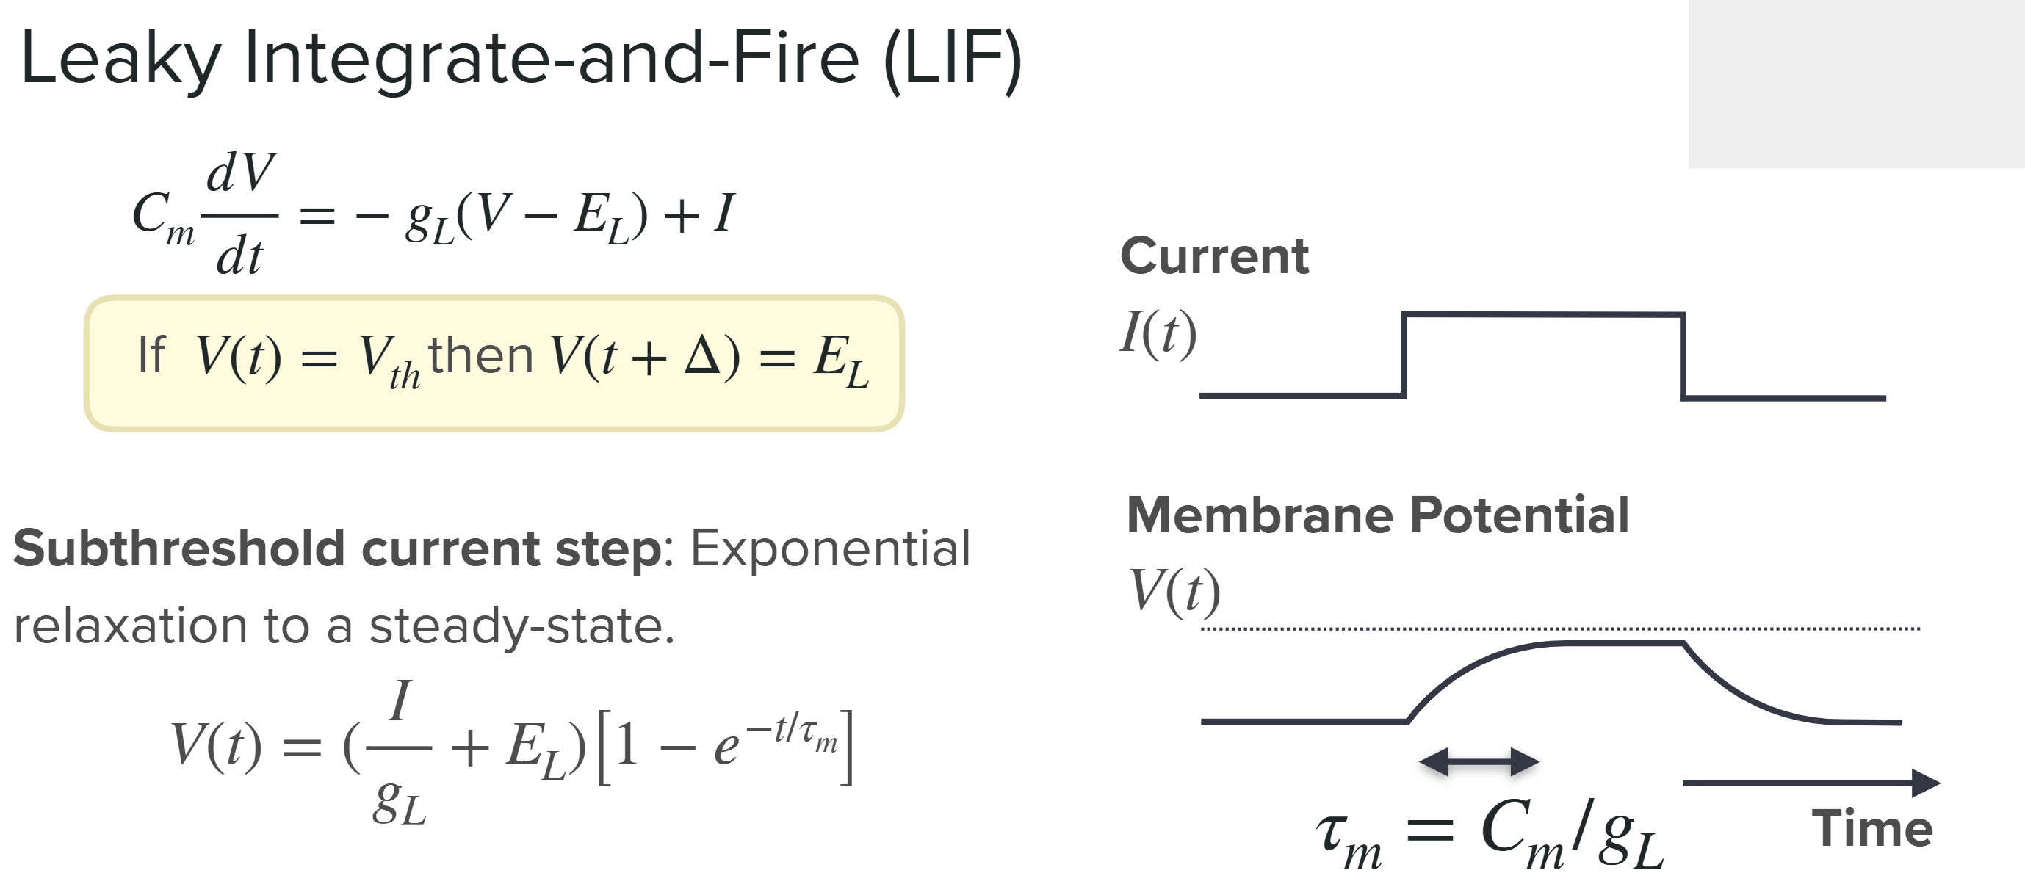
https://compneuro.neuromatch.io/

Slide 9
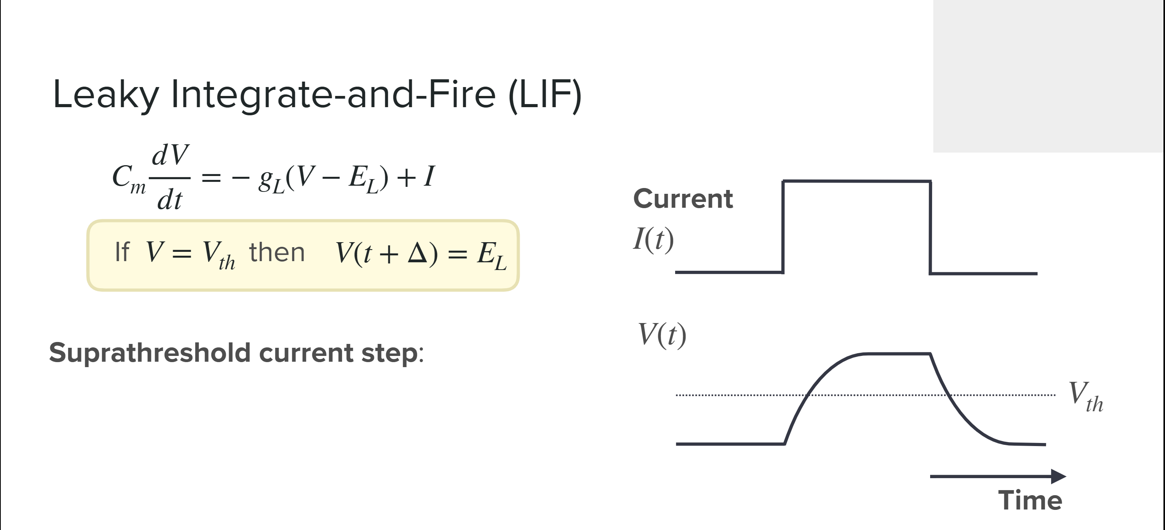
https://compneuro.neuromatch.io/

Slide 10
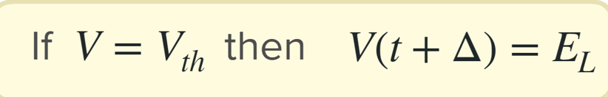
Exercise (Write a MATLAB code for simulation of LIF model)
Hint:
tau = 0.010; % Membrane time constant (tau) in seconds
E_L = -0.070; % Leak potential (also known as resting potential) in volts
Vth = -0.050; % Threshold potential in volts (the potential at which a spike is generated)
Vreset = -0.080; % Reset potential in volts (the potential after a spike)
Cm = 100e-12; % Total membrane capacitance in farads
G_L = Cm / tau; % Total membrane conductance (leak conductance) in siemens
Iapp = 210e-12; % Value of applied current steps in amperes
V(i) = V(i-1) + dt * (I(i) + G_L * (E_L - V(i-1))) / Cm; % Update membrane potential using Forward Euler method

Slide 11

THANK YOU

